Slide 1
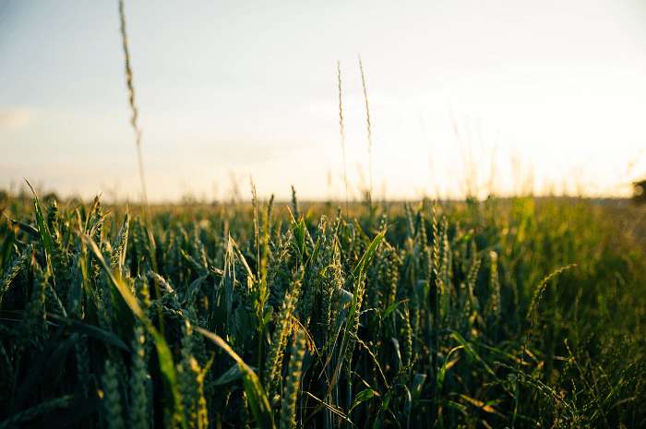
Forecasting Crop Yields Using Statistical Models
Adity Banerjee (BS2304)
Akanksha Das (BS2307)
Mayank Mitra (BS2331)
Rahul Ganguly (BS2337)
Sohan Karmakar (BS2349)
Unnati Mandal (BS2355)

Slide 2
Data Exploration:
 | Rainfall (mm) | Avg Temp | Fertilizer (kg/ha) | Pest Incidents | Technology Index | Crop Yield (ton/ha)
Mean | 1132.278 | 27.184 | 240.4024 | 3.12 | 67.1704 | 6.6584
Median | 1189.57 | 26.55 | 265.81 | 2 | 71.29 | 6.89
Range | 836.02 | 13.57 | 168.6 | 9 | 59.4 | 6.86
SD | 217.4466 | 4.314433 | 59.91522 | 2.650786 | 20.26637 | 2.158081
• Moderately high variability in all of the variables implies that none of the variables are remotely stable with time.
• Pest incident is the only positively skewed factor(apart from temperature) suggesting the variability is caused mainly by few years when the pest incidents are at their peak.
• High range in Technology Index shows the improvement of its implementation in agriculture with time.
• Rainfall varies significantly with a high range and being an important factor in crop yield is worth studying.
• Temperature on the other hand has a lower variance and range compared to Rainfall. So, it can definitely be considered a more stable natural factor.

Slide 3
Correlation With Crop Yield:
 | Rainfall (mm) | Avg Temp | Fertilizer (kg/ha) | Pest Incidents | Technology Index
Correlation | 0.7481621 | -0.9373517 | 0.6895067 | -0.3881811 | 0.6064945
Very high negative correlation between Temp and Yield implies temperature and global warming as an important factor affecting agriculture.
Moderately high and positive linear link between Crop yield and Fertilizer used as well as Technology suggest that these two factors require proper attention for maximizing agricultural progress.
A high positive correlation with Rainfall tells us importance of rainfall, the main source of irrigation in agriculture.

Slide 4
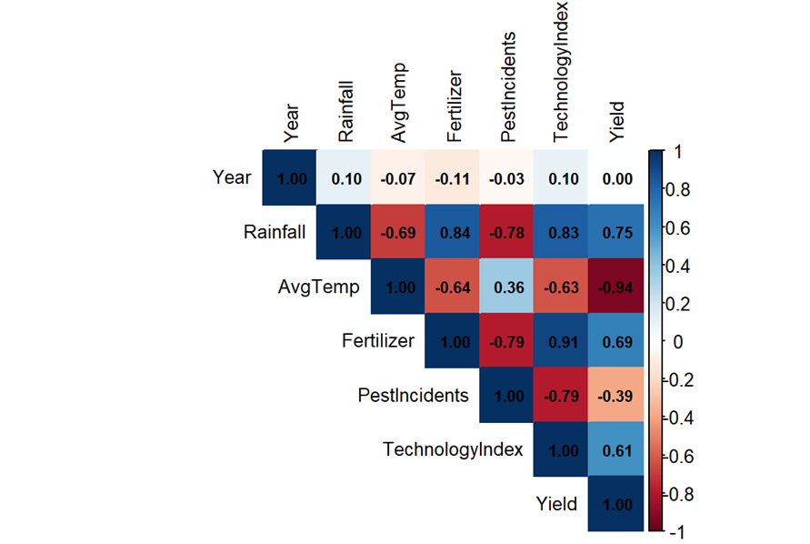
Correlation Heatmap:

Slide 5
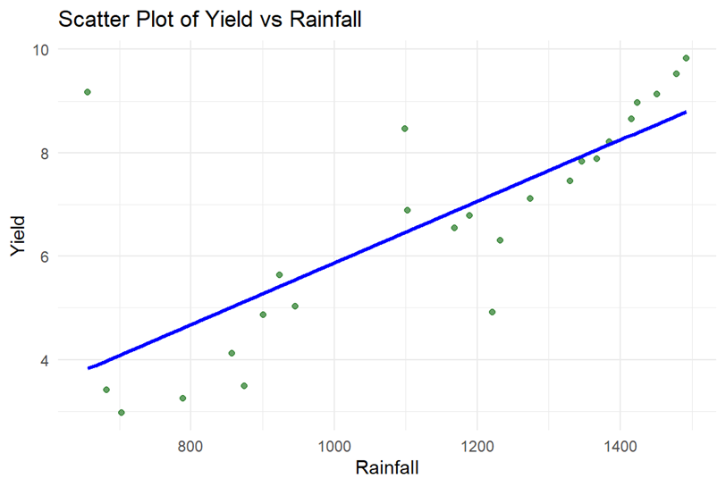
Visualization :
.
As rainfall increases, the crop yield also increases, which is shown by the upward trend and the fitted blue regression line.
This suggests that rainfall plays a significant role in boosting agricultural productivity — likely because water is a key input in crop growth.

Slide 6
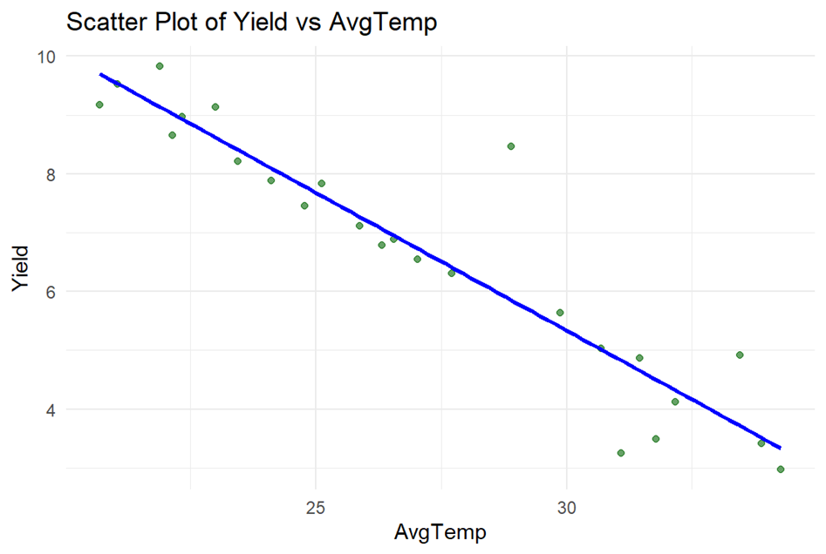
The blue regression line slopes downward, indicating that higher temperatures are associated with lower yields.
This makes sense agriculturally:
High temperatures can cause heat stress in crops.
It increases evapotranspiration, drying out soil moisture faster.

Slide 7
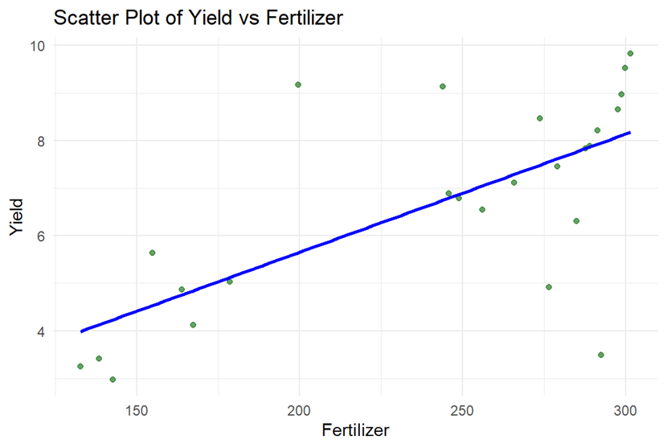
The blue regression line shows an upward trend, indicating that increasing fertilizer tends to increase yield.
However, there's more scatter around the line compared to the rainfall plot, which means:
The effect of fertilizer on yield is less consistent.
Overuse of fertilizer could lead to negative effects, possibly explaining some of the outliers.

Slide 8
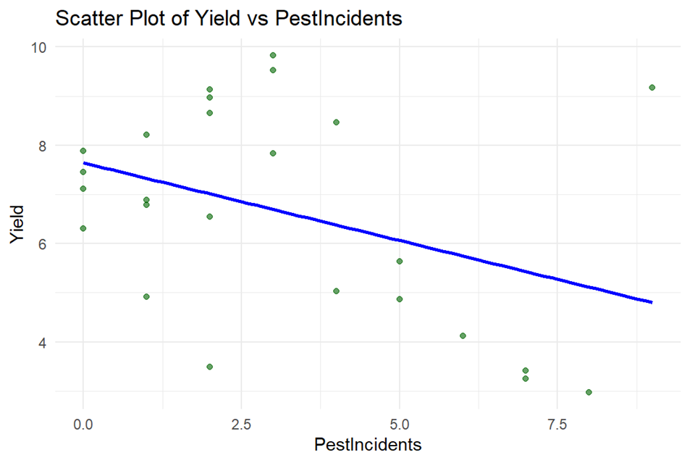
The blue regression line slopes downward, confirming the overall negative trend.
Pest control alone isn't sufficient to ensure high productivity.

Slide 9
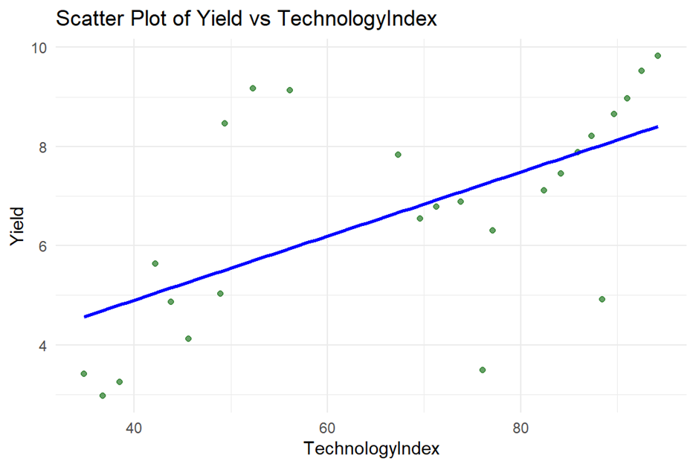
The blue regression line slopes upward, showing a strong positive linear trend.
Investment in agricultural technology (like irrigation systems) pays off in terms of higher yield.

Slide 10
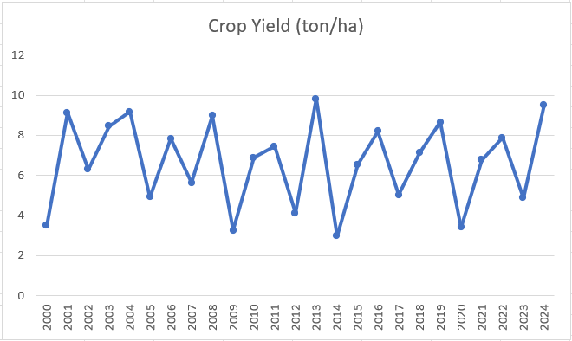
Time Series Plot:
Observations:
High Variability: Ranging between approximately 3 to 10 tons per hectare.
No Clear Trend: There is no obvious long-term increase or decrease.
Low Yield Years: 2009, 2012, 2014, 2020, and 2023
High Yield Years: 2001, 2004, 2008, 2013, and 2024, with 2024 marking one of the highest yields.
Potential Recovery in 2024: Despite previous dips, crop yield in 2024 shows a strong recovery.

Slide 11
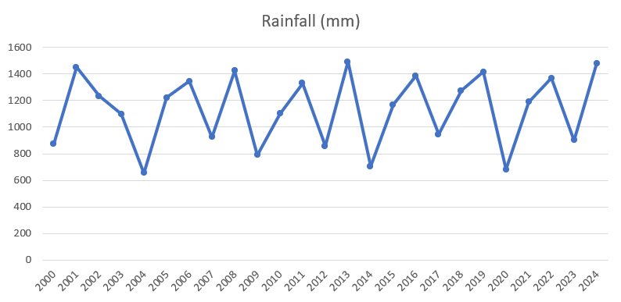
Observations:
Fluctuating Trend: High fluctuating pattern.
No Strong Trend: No consistent upward or downward trajectory.
Peaks and Lows: Peaks: 2001, 2008, 2011,2013, 2016, and 2024. And lows: 2004, 2009, 2014, and 2020.

Slide 12
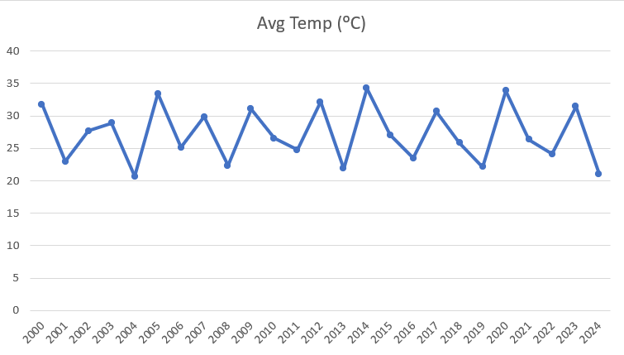
Observations:
Fluctuating Pattern: Ranging mostly between 21°C and 35°C, showing no consistent upward or downward trend.
Highs and Lows: Peaks : 2005, 2012, 2015,2017 and 2021. And lows: 2004, 2008, 2013, 2019, and 2024.
Sharp Drop in 2024: The year 2024 recorded one of the lowest average temperatures in the entire dataset.

Slide 13
Model Building:
We have created 2 different Prediction Models to predict Crop Yield based on the different parameters: Rainfall, Temperature, Pest Incidents, Technology Index and Fertilizers used.
1.
Gaussian Ridge Regression Model
2.
Random Forest Regression Model

Slide 14
Gaussian Ridge Regression Model:
This Model Consists of:
A probabilistic linear model with L2 regularization and assumes Gaussian priors for regression coefficients.
Reduces overfitting and handles noisy or limited data effectively.
Provides uncertainty estimates, improving prediction reliability.
Useful for modelling relationships between agricultural inputs and crop yield.
Supports data-driven decisions in precision agriculture.

Slide 15
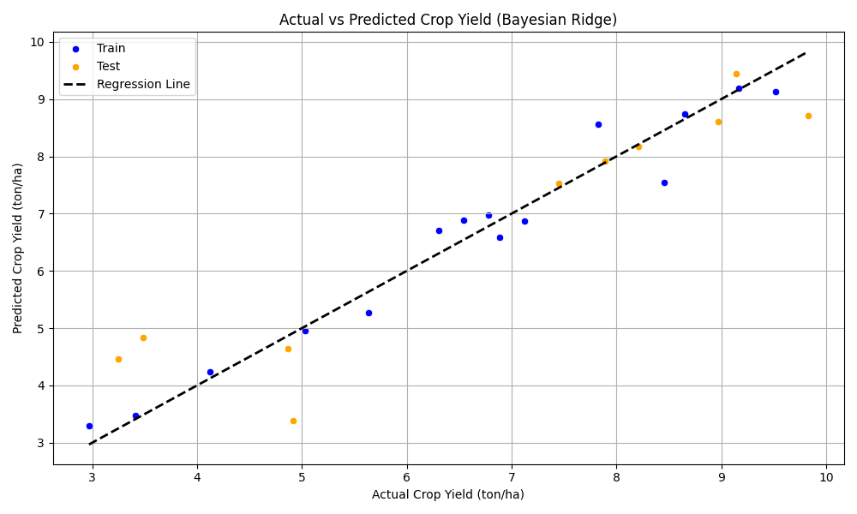
Model Validation:
Closer points to the diagonal line mean better accuracy.
Training data (blue) aligns closely with the ideal line; test data (orange) shows more spread, as expected.
Errors are higher in low-yield cases (<5 ton/ha), especially in test data.
Mid to high-yield predictions are accurate, with strong R^2 values and good generalization.
Overall, the model is reliable, with slight room for improvement in low-yield predictions.

Slide 16
Results Interpretation:
High accuracy on training and good generalization on test data.
Slight performance drop on unseen data is expected but acceptable.
Model performs best in mid-to-high yield ranges, slight underperformance in low-yield cases.

Slide 17
Model Validation and Forecasting:
METRIC | VALUE | INTERPRETATION
RMSE | 0.387 | Root Mean Squared Error
R^2 | 96.10% | Model explains 96.10% of variance
Adjusted R^2 | 91.6% | Model explains 91.6% of variance
Evaluation On Training Dataset
METRIC | VALUE | INTERPRETATION
RMSE | 0.846 | Root Mean Squared Error
R^2 | 86.67% | Model explains 86.67% of variance
Adjusted R^2 | 96.5% | Model explains 96.5% of variance
Evaluation On Test Dataset

Slide 18
Feature Contribution Analysis:
Feature | MSE Contribution
Avg Temp (°C) | 3.599122
Fertilizer (kg/ha) | 0.540140
Technology Index | 0.355052
Rainfall (mm) | 0.091410
Pest Incidents | 0.015407
Avg Temperature is the most influential predictor, followed by Fertilizer and Tech Index.
Rainfall has a small impact, likely due to limited variation in the data or its effect being influenced by factors like temperature and fertilizer.
Pest incidents contribute least to MSE, suggesting effective control or lower impact and variability compared to temperature and fertilizer.

Slide 19
Random Forest Regression Model:
Model Overview:
Random Forest is an ensemble learning method that builds multiple decision trees and averages their predictions and reduces overfitting. Each tree is trained on a random subset of data (bootstrap sample) and uses a random subset of features at each split.

Slide 20
Model Validation and Forecasting:
Evaluation On Training Dataset:
METRIC | VALUE | INTERPRETATION
RMSE | 1.42 | Root Mean Squared Error
R^2 | 81.93% | Model explains 81.93% of variance
Evaluation On Test Dataset:
METRIC | VALUE | INTERPRETATION
RMSE | 1.20 | Root Mean Squared Error
R^2 | 66.02% | Model explains 66.02% of variance

Slide 21
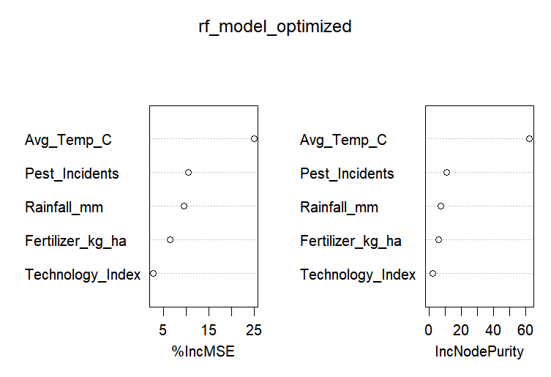
Variable Importance Plot:
%IncMSE(Left Plot)
Higher increase in MSE from permuting/randomizing a variable indicates its importance—greater drop in model performance means the variable is more crucial.
IncNodePurity(Right Plot)
It measures the total reduction in variance (node impurity) from splits on a variable across all decision trees.
From the Graph
In both cases, Avg_Temp_C is the most important feature, Technology_Index has the least impact on model error, while Pest_Incidents and Rainfall_mm contribute meaningfully.

Slide 22
Model Validation and Forecasting:
Variable | Forecasted Value
Rainfall | 1236.78mm
Average Temperature | 25.82 °C
Fertilizer Use | 261.0338 kg/ha
Technology Index | 74.07 units
Pest Incident | 3 incidents
Predicted Crop Yield | 7.0971 ton/ha

Slide 23
Optimization Problem to maximize Crop Yield (ton/ha) using Random Forest Regression:
We Categorise the variables into 2 categories:- Type 1 and Type 2.
Type 1 (Controllable/Human Factors) variables, are those predictor variables which can be controlled by the farmers ( In our case- Amount of Fertiliser used, Level of Technology used).
Type 2 (Uncontrollable/Environment Factors) Variables, are those variables which are independent and cannot be controlled by the farmers (In our case, temperature, rainfall and pest incidents).

Slide 24
Aim:
Our aim is to maximize crop yield by controlling Type 1 variables based on known values of Type 2 variables, which can take any value.
Process:
While excessive use of fertilizers and high-tech investments may boost yield, it's unrealistic for resource-limited farmers, so we introduce a new variable: Expenditure, to reflect this constraint in our optimization.

Slide 25
Expenditure is a special Type 1 variable dependent on original Type 1 variables, defined as:
Expenditure = 2 * Fertilizer (Kg/Ha) + 5 * Technology Index.
where weights are arbitrary and highlight higher investment in technology than fertilizer.
Our optimization problem aims to find optimal Type 1 variable values for maximum crop yield, given known Type 2 values and subject to the constraint that total expenditure stays below a known constant k.

Slide 26
We use Bayesian Optimization with the Random Forest Regression model discussed before, fixing the expenditure limit at 1000 units and using forecasted Type 2 variables—Rainfall, Temperature, and Pest levels—to estimate how varying Fertilizer and Tech Index values impact yield.
Bayesian Optimization intelligently selects Fertilizer and Tech Index combinations to test, aiming to maximize yield while ensuring 2×Fertilizer + 5×Tech Index ≤ 1000, thus staying within resource limits.
The model acts as a surrogate for the real-world function, using an acquisition function to balance exploration (trying less-tested combinations) and exploitation (focusing on promising areas) when deciding the next best point to evaluate.

Slide 27
Input Table:
Variable | Value | Unit
Rainfall | 1236.78 | mm
Average Temperature | 25.82 | °C
Pest Incidents | 3 | count
The Optimisation process provides the following results:
Variable | Value | Unit
Fertilizer Application | 312.34 | kg/ha
Technology Investment | 61.48 | units
Predicted Crop Yield | 7.78 | ton/ha
Total Expenditure | 932.08 | units
Budget Utilization | 93.2 | %

Slide 28
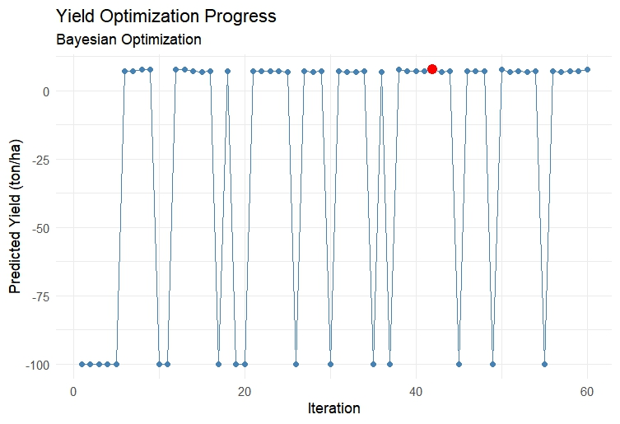
Optimization Problem to maximize Crop Yield (ton/ha) using Random Forest Regression:
The algorithm quickly finds solutions with yields around 7.78 ton/ha.
Negative values early on represent random uninformed exploration or it may be penalty scores for budget violations. I.e. the model assigns large negative values when prediction is invalid, or it violates the parametric conditions.
The later fluctuations indicates the algorithm trying new combinations.
The slight stable parts indicates convergence to the optimal solution.
RED DOT indicates best Predicted Crop Yield.

Slide 29
Prediction of Human factors for desired crop yield:
1.Technological Index Model(Target Variable: Technology Index)
METRIC | VALUE | INTERPRETATION
RMSE | 3.744 | Root Mean Squared Error
R^2 | 95.9% | Model explains 95.9% of variance
Adjusted R^2 | 86.2% | Model explains 86.2% of variance
Evaluation Metrics on Training Dataset
METRIC | VALUE | INTERPRETATION
RMSE | 12.805 | Root Mean Squared Error
R^2 | 57.2% | Model explains 57.2% of variance
Adjusted R^2 | 81.5% | Model explains 81.5% of variance
Evaluation Metrics on Test Dataset

Slide 30
2.Fertilizer Model(Target Variable: Fertilizer)
METRIC | VALUE | INTERPRETATION
RMSE | 15.72 | Root Mean Squared Error
R^2 | 92.5% | Model explains 92.5% of variance
Adjusted R^2 | 87.2% | Model explains 87.2% of variance
Evaluation Metrics on Training Dataset
METRIC | VALUE | INTERPRETATION
RMSE | 37.029 | Root Mean Squared Error
R^2 | 57.5% | Model explains 57.5% of variance
Adjusted R^2 | 86.1% | Model explains 86.1% of varaiance
Evaluation Metrics on Test Dataset

Slide 31
Future Work:
In the future, this work can be improved by collecting more recent and detailed data to make predictions more accurate. Including information from different regions or states could help the model understand local patterns better. Simple weather forecasts can also be added to improve future yield estimates. Another useful step would be to build a basic mobile or web app so that farmers or policymakers can easily input values and get suggestions. Lastly, testing these models in real farms and comparing the predicted results with actual outcomes would help improve and trust the system more.

Slide 32
THANK YOU

